Slide 1

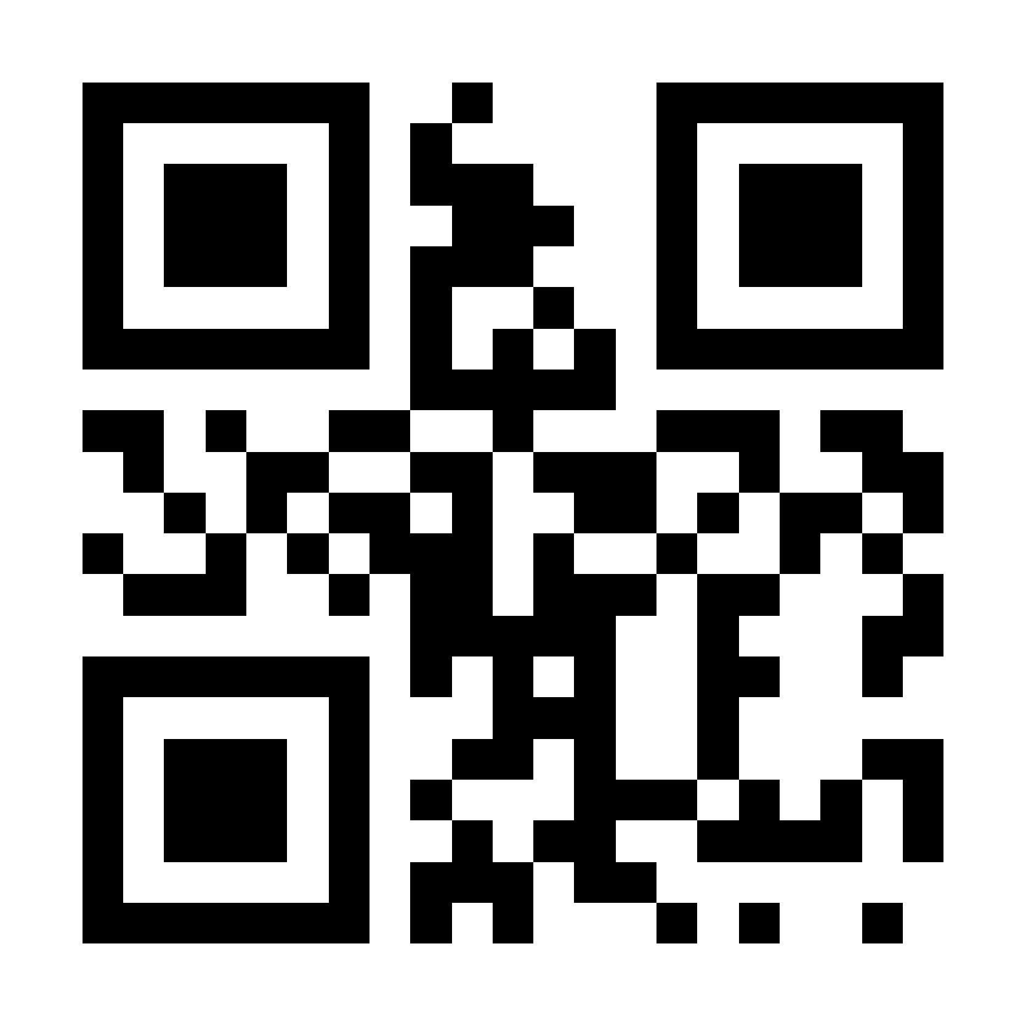
Georgia Probe College Tour
February 4, 2026 –
March 13, 2026
Connect with college representatives. Ask questions about your major, admissions, scholarships, and more!
RegisterProbe.com

