Slide 1

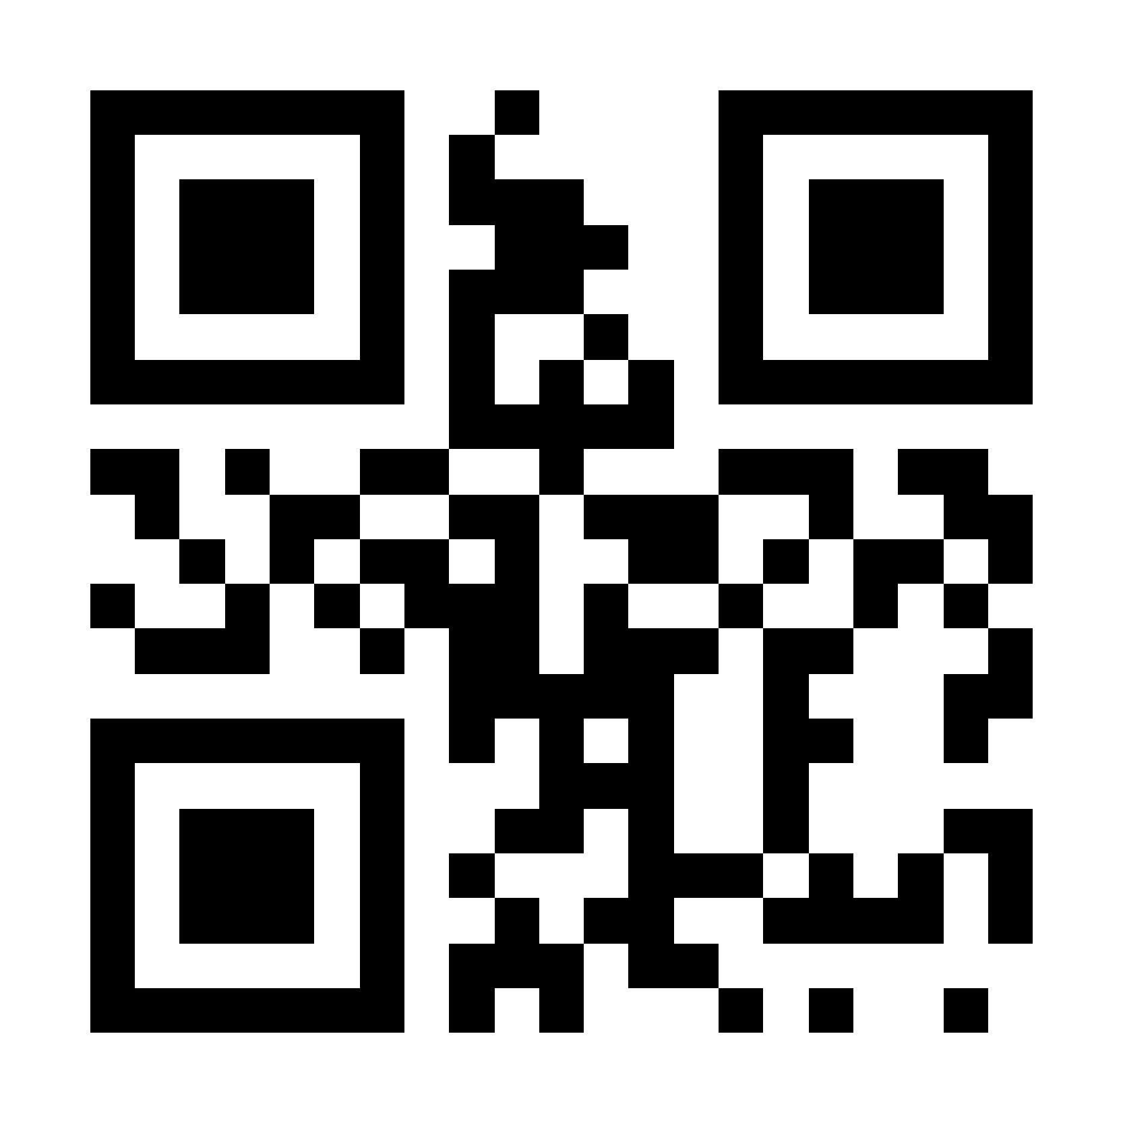
Georgia Probe College Tour
February 20, 2025 –
March 21, 2025
Meet with college and university representatives from around the world.
RegisterProbe.com

